Slide 1
Lecture 4
STAT 451 VISUALIZING DATA
Fall 2023
Many thanks to Prof. Abel Rodriguez, many slides from this course are adapted from his data visualization class.

Slide 2
The best graph is the simplest graph
that makes the desired point!

Slide 3
The structure of visualizations
Visualizations can be divided into four components:
The visual cues that are used to represent each variable in the data.
The coordinate system that is used for each variable.
The scale that is used to represent each variable.
The contextual information that is used to help readers understand the visualization.

Slide 4
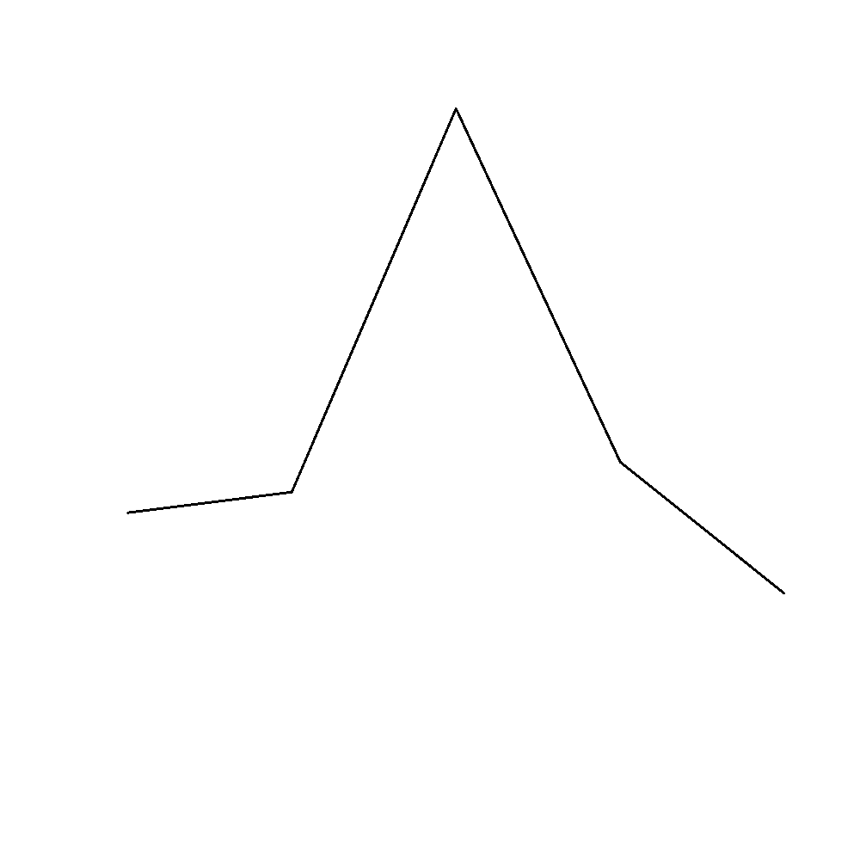
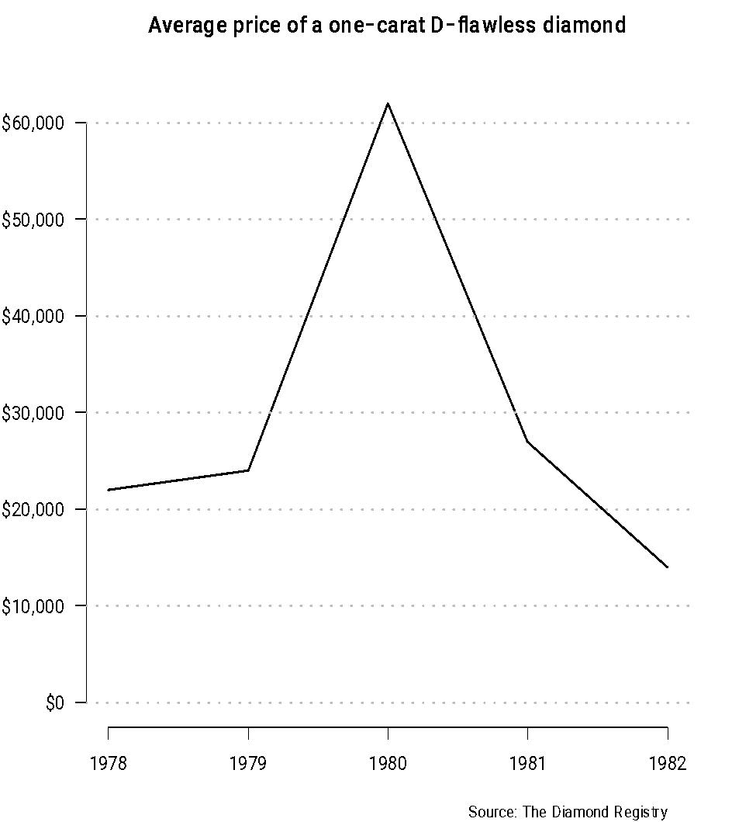
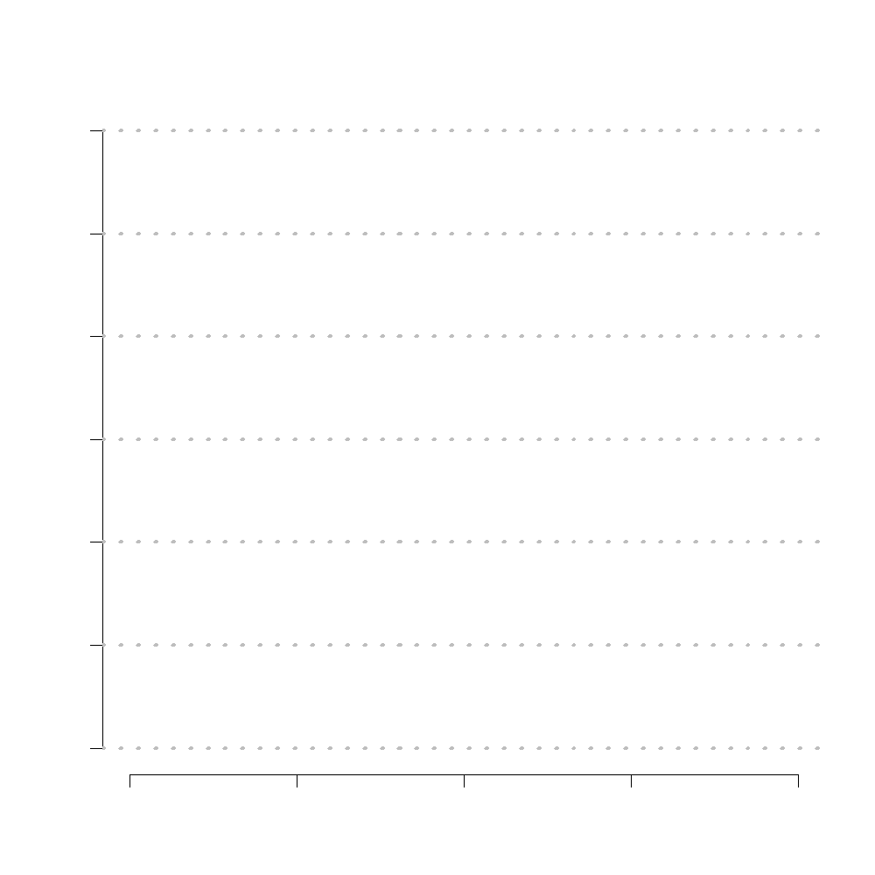
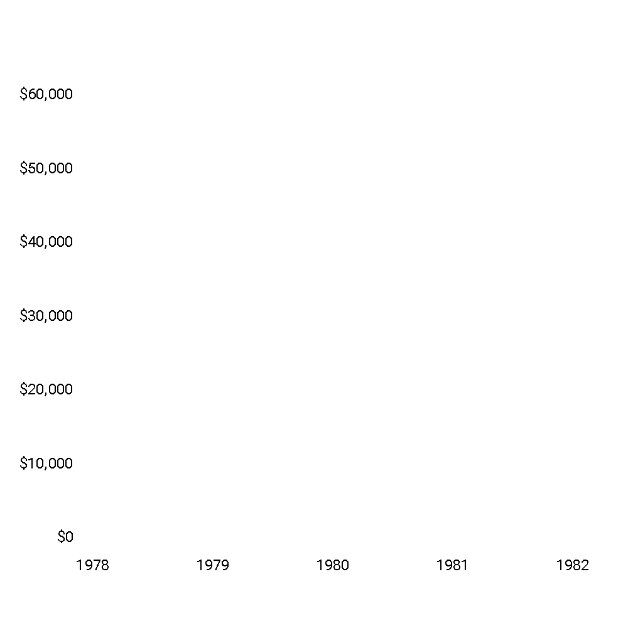

The structure of visualizations
Visual cues
Coordinate system
Scale
Context

Slide 5
Visual cues
The key to making graphs that are visually appealing and easier to understand is to use visual cues that engage pre-attentive processing to transmit the most important information.
Pre-attentive processing is the unconscious accumulation of information from the environment.

Slide 6
Pre-attentive processing
For many years vision researchers have been investigating how the human visual system analyses images.
An important initial result was the discovery of a limited set of visual properties that are detected very rapidly and accurately by the low-level visual system.
These properties were initially called pre-attentive, since their detection seemed to precede focused attention.

Slide 7
Pre-attentive processing
We now know that attention plays a critical role in what we see, even at this early stage of vision. The term pre-attentive continues to be used, however, since it conveys an intuitive notion of the speed and ease with which these properties are identified.
Typically, tasks that can be performed on large multi-element displays in less than 200 to 250 milliseconds (msec) are considered pre-attentive.

Slide 8
Pre-attentive processing
Eye movements take at least 200 msec to initiate, and random locations of the elements in the display ensure that attention cannot be pre-focused on any particular location, yet viewers report that these tasks can be completed with very little effort.
This suggests that certain information in the display is processed in parallel by the low-level visual system.

Slide 9
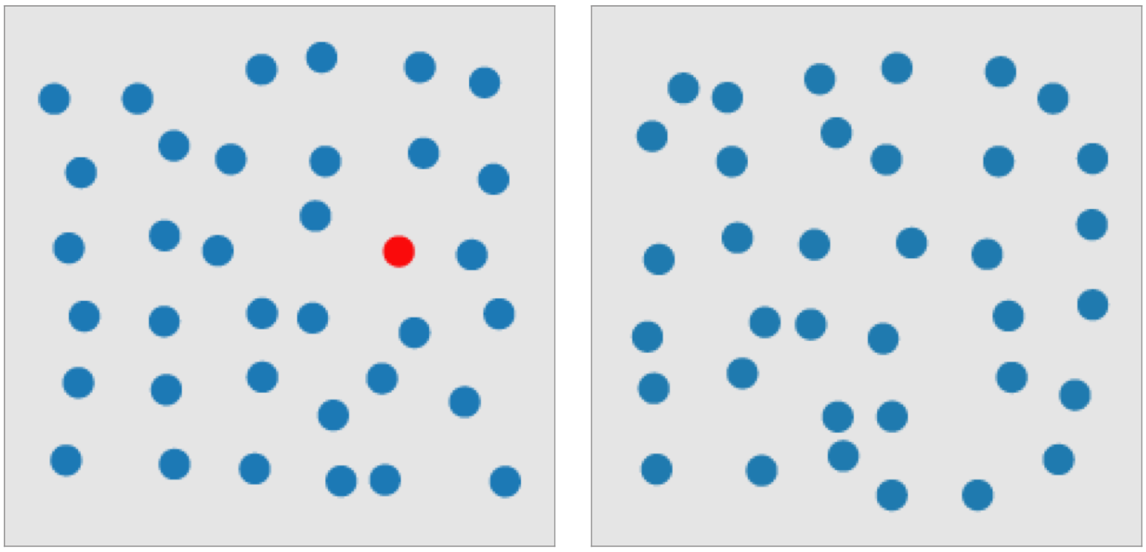
Pre-attentive processing
A simple example of a task accomplished by pre-attentive processing is finding a red symbol in a sea of blue “distractors”.

Slide 10
Pre-attentive attributes
Category | Attribute
Form | Orientation
 | Line length
 | Line width
 | Size
 | Shape
 | Curvature
 | Added marks
 | Enclosure
Color | Hue
 | Intensity
Spatial position | 2-D position
Motion | Flicker
 | Direction

Slide 11
Visual cues
Usual visual cues involve position, length, angle, direction, shape, area, volume and color.
However, not all visual cues are equally effective, and their effectiveness depends on whether the type of variable you are trying to represent.

Slide 12
Types of data
A usual classification:
Qualitative (or categorical).
Quantitative.

Slide 13
Types of Data
Qualitative data, also called categorical or attribute data. These can be separated into different categories that are distinguished by some non-numeric characteristics.
Nominal data consist of names, labels or categories only. There is no natural ordering to these categories.
Ordinal data can be arranged in some order but differences between data values either cannot be determined or are meaningless.

Slide 14
Examples of nominal variables
Party to which a politician belongs.
Types of listings in AirBnB (apartment, house, castle, igloo, etc).
Type of worker in the weaving dataset (home or factory weaver).
Eye color (black, blue, brown, black).

Slide 15
Example of an ordinal variable
This scale is used to classify the performance status of patients in a clinical trial.
The score of a patient in this scale is a categorical variable. The categories are ordered, but the differences in magnitude are meaningless.
 | Description
0 | Fully active, able to carry on all pre-disease performance without restriction.
1 | Restricted in physically strenuous activity but ambulatory and able to carry out work of a light or sedentary nature.
2 | Ambulatory and capable of all self-care but unable to carry out any work activities; up and about more than 50% of waking hours.
3 | Capable of only limited self-care; confined to bed or chair more than 50% of waking hours.
4 | Completely disabled; not capable of any self-care; totally confined to bed or chair.

Slide 16
Types of Data
Quantitative data consists of numbers representing counts or measurements.
Discrete data: the number of possible values is either a finite number or a countable number.
Continuous data: are the result from infinitely many possible values not restricted to certain specified values.

Slide 17
Examples of discrete data
Number of new cases of breast cancer reported annually from 1995 to 2002.
Number of people who voted for Barack Obama in each state in the 2012 presidential election.
Note that in some cases discrete data is obtained by “summarizing” qualitative data (i.e., counting the number of cases associated with each category).

Slide 18
Examples of continuous data
Unemployment rate.
Inflation rate.
Change in gross domestic product.
Temperature.
Weight.
Bank capitalization

Slide 19
Cognitive scale of visual cues for quantitative variables
Position
Length
Angle
Direction
Shape
Area
Volume
Color saturation
Color Hue
More accurate comparisons
Less accurate
comparisons

Slide 20
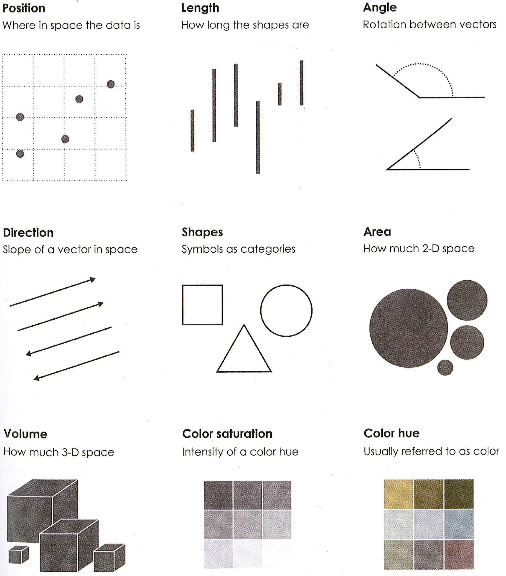
Cognitive scale of visual cues for quantitative variables
Taken from “Data Points” by Nathan Yau

Slide 21
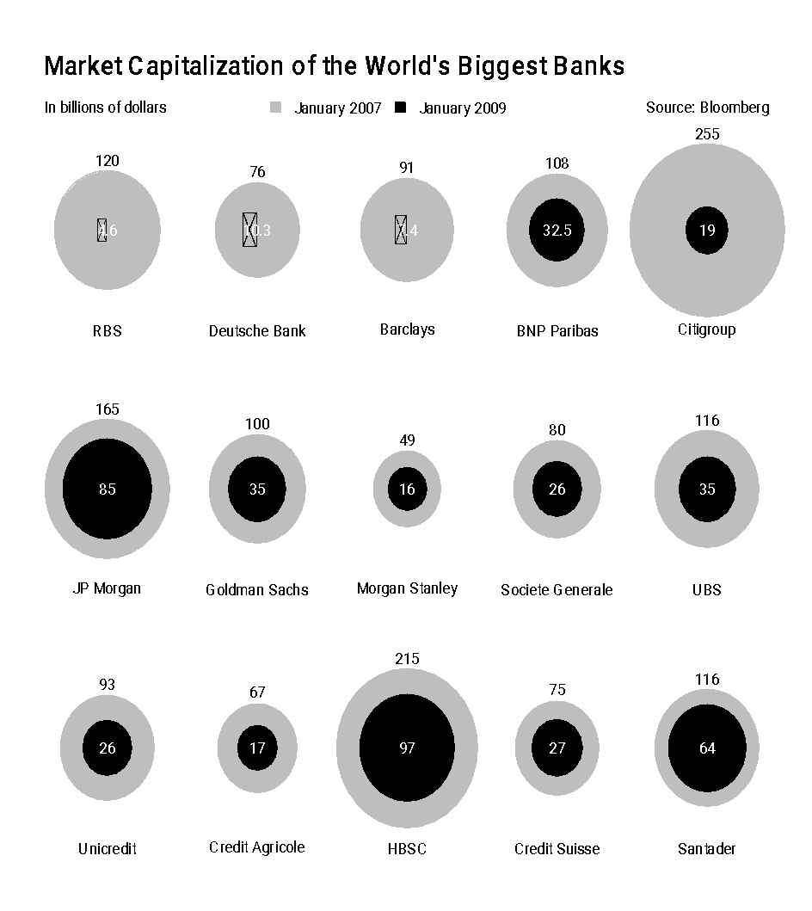
The accuracy of visual clues
This graph shows the market capitalization of the worlds biggest banks in January 2007 and January 2009.
The original version was published by J.P. Morgan. This is a reinterpretation of the original graph (which we will see later).

Slide 22
The accuracy of visual clues
What is the main point of the visualization?
Did banks increase or lost market capitalization?
Which banks lost the most?
Which banks lost the least?
How much market value was lost overall?
How much market values was lost by the biggest losers?
How much market values was lost by the banks that fared better?

Slide 23
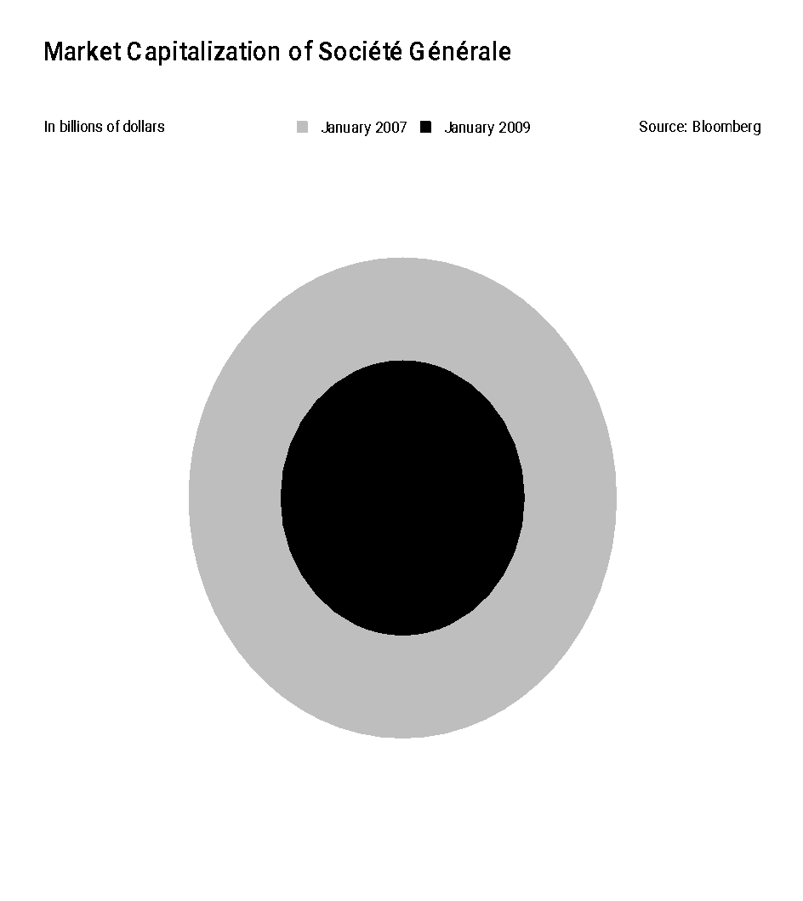
The accuracy of visual clues
Let’s focus on one specific bank.
If the largest bubble represents $80 billion, how much money does the second bubble represents?
Slightly less than than $40 billion?
Slightly more than $25 billion?
Slightly more than $50 billions?

Slide 24
The accuracy of visual clues
This graph is appropriate for communicating the main message (banks lost market capitalization, the bigger losers were RBS and Citigroup), but not appropriate for making detailed comparisons among how big the losses are!

Slide 25
A side point…
Does the choice of dates matter?
When was the climax of the financial crises?
What if we had chosen 2011 instead of 2009?

Slide 26
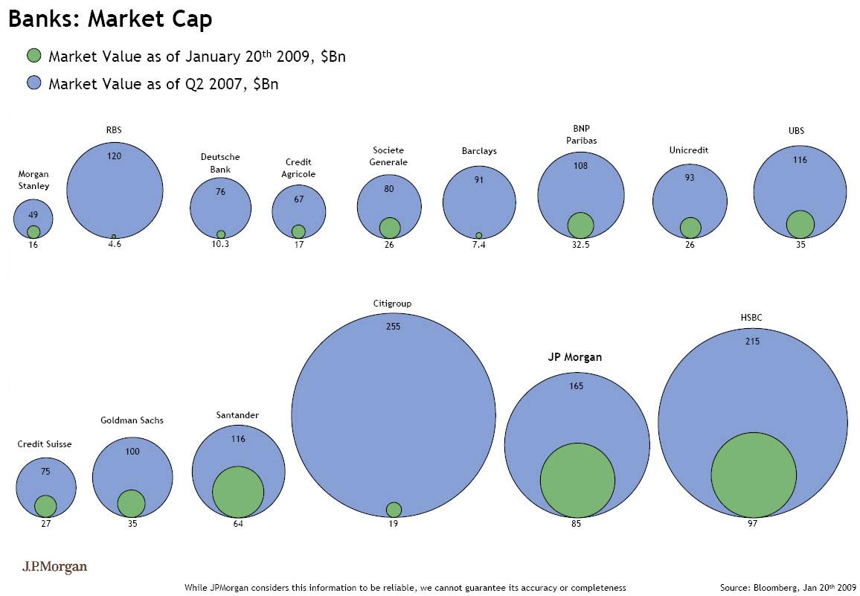
Other issues with areas
Original visualization created by J.P. Morgan Bank. Taken from http://www.perceptualedge.com/example18.php

Slide 27
Other issues with areas
Without looking at the numbers, how much market value did Goldman Sachs lose?
About 65%?
About 75%?
About 85%?
Now, look at the numbers and give the right answer…

Slide 28
Other issues with areas
Why does the graph appear to give the wrong message?
Values are encoded through the diameters, but the eye is might be trying compare the areas! This is a common problem with bubble plots.
This “trick” helps in making the differences across banks appear bigger than they really are.
What makes it even worse is that there is no hint in the graph that suggests that you should be looking at the diameters rather than the areas.

Slide 29
Other issues with areas
Areas scale as the square of the other dimensions!
Multiply the height and (to keep the aspect ratio) also the width by 2, and the area is multiplied by 4!
Multiply the height and width by 3, and the area is 9 times larger!
You can imagine how this becomes even worse if volumes are used: That is why unnecessary 3D effects should be discouraged!

Slide 30
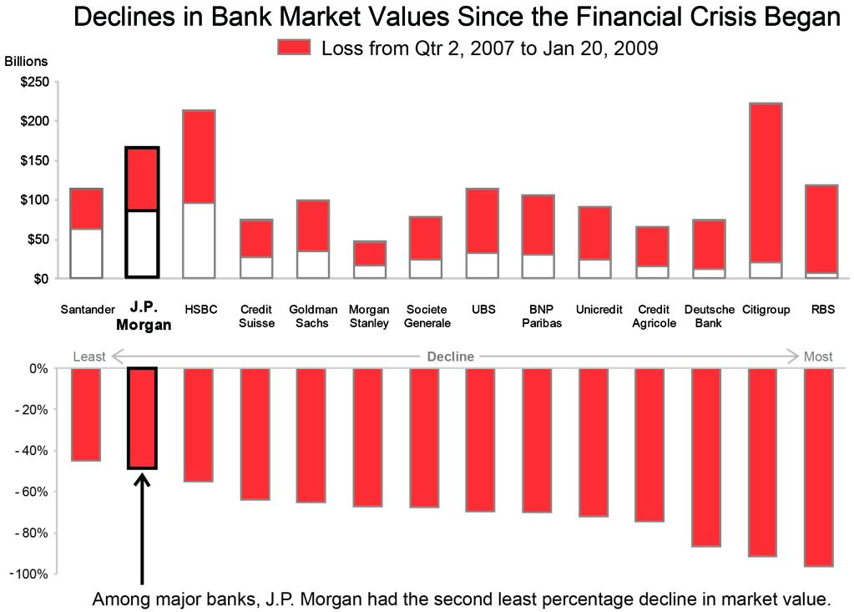
Stephen Few’s visualization for the Bank’s market capitalization
Stephen Few suggests using two sets of bar plots, one showing absolute values, and a second one showing relative declines.
Much easier to make comparisons because cue is higher in the cognitive scale.
Additional text highlights J.P. Morgan!
Taken from http://www.perceptualedge.com/example18.php

Slide 31
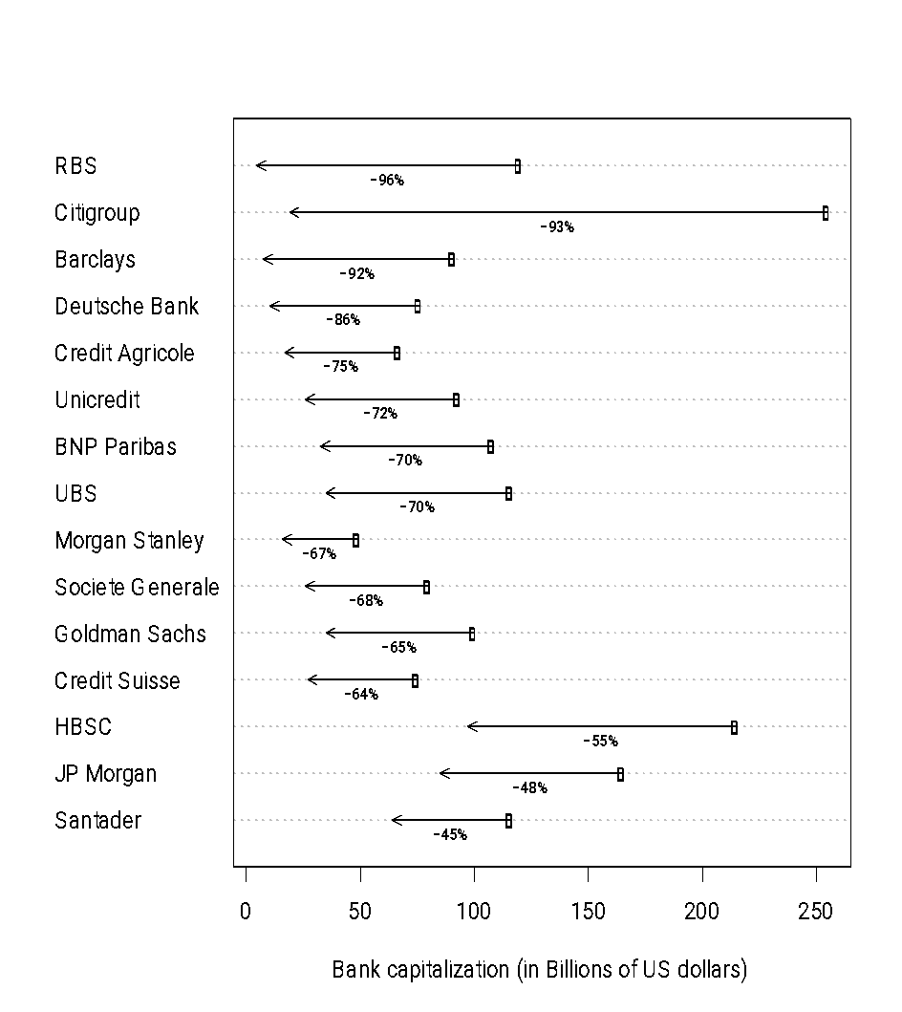
Alberto Cairo’s visualization for the Bank’s market capitalization
Cairo suggest a dot plot to represent the changes in market capitalization.
This allows for more accurate comparisons, because the visual cue used is higher in the cognitive scale.
Including 0 in the scale is important to preserve the proportions!

Slide 32
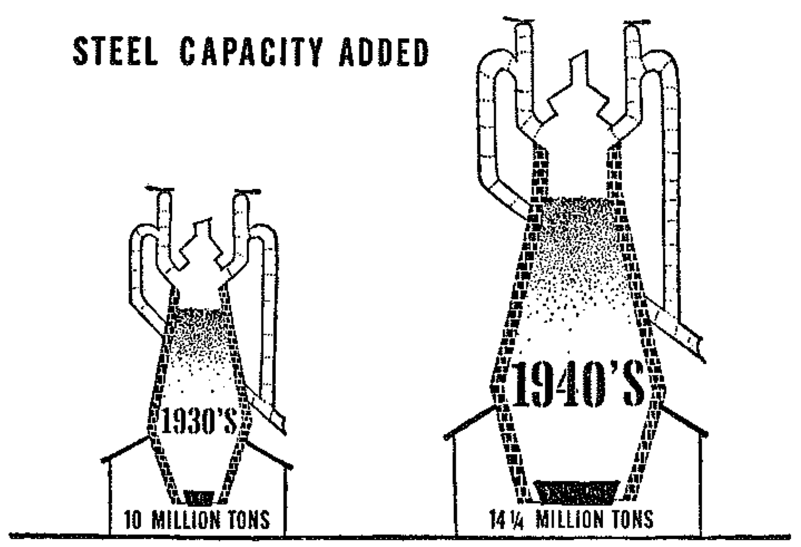
The accuracy of visual clues
Another example coming from Darrel Huff’s book.
Again, without looking at the numbers, is the capacity in the 1940s:
About one and half times as big as in 1930s.
About twice as big as in 1930s.
About two and a half time as big as in 1930s.
From “How to Lie with Statistics”, by Darrel Huff

Slide 33
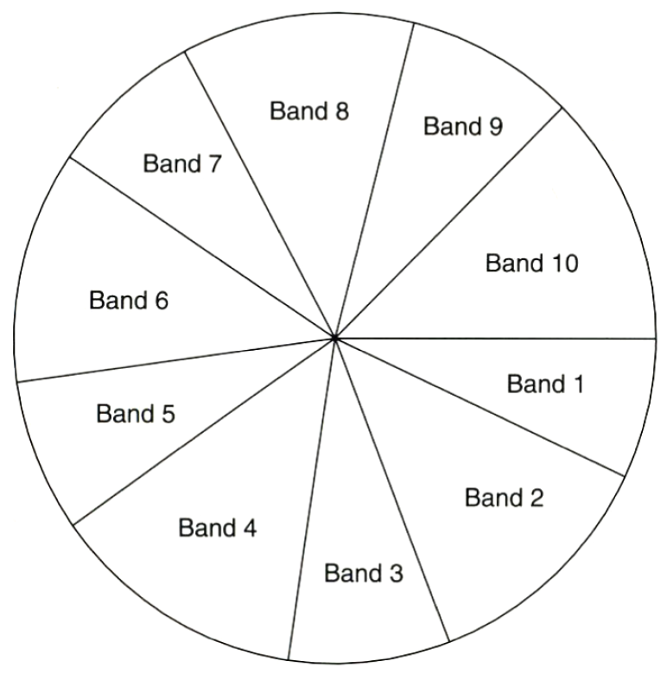
The accuracy of visual clues
This is an example of a pie chart, which are extremely popular.
Can you describe these data? What are the relative sizes of the slices?
From “The Elements of Graphing Data”, by Cleveland.

Slide 34
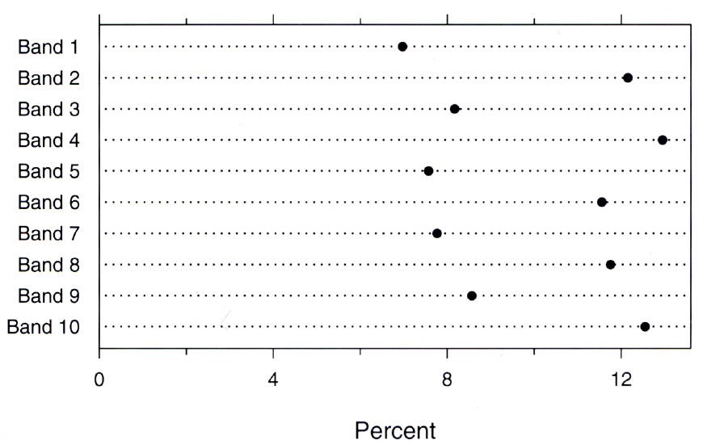
The accuracy of visual clues
An alternative solution is to use a dot plot (which uses visual cues that are higher in our cognitive scale).
Did you realize that some slices are 50% bigger than others?
From “The Elements of Graphing Data”, by Cleveland.

Slide 35
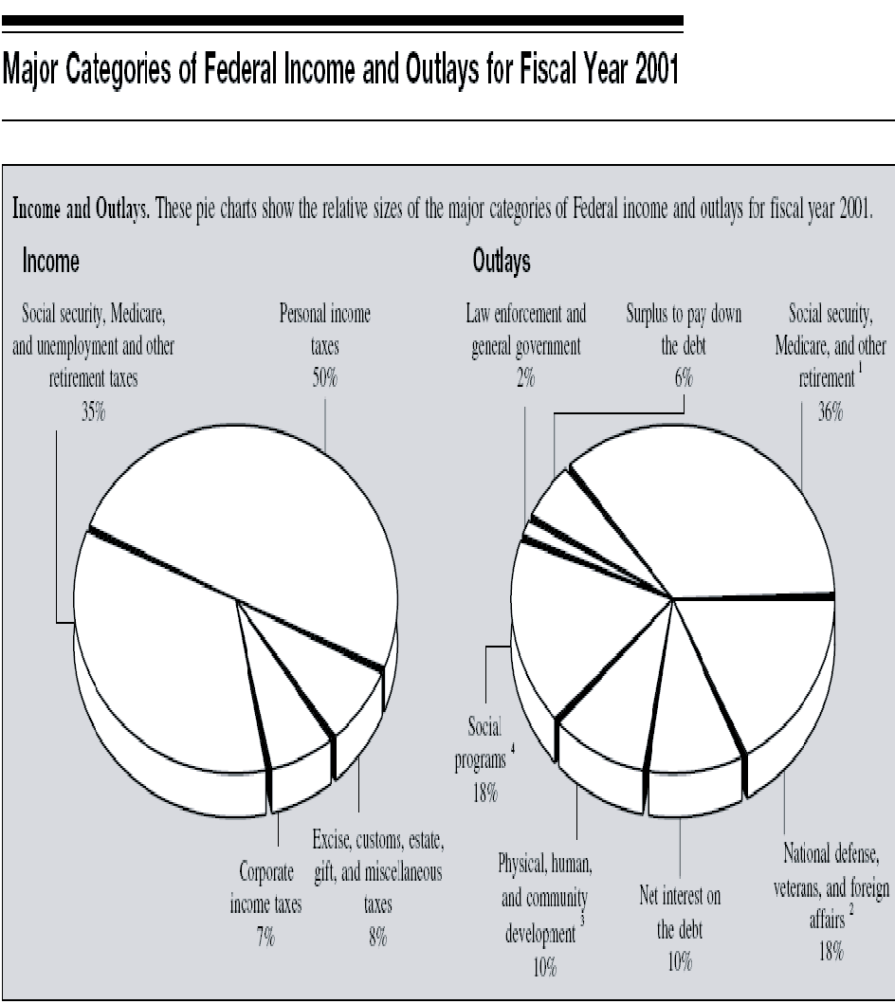
Evaluating pie charts …
The Internal Revenue Service (IRS) uses pie charts in the back of US tax forms to explain federal incomes and outlays.
Areas are relatively low in the cognitive scale. Can a dot plot be better?

Slide 36
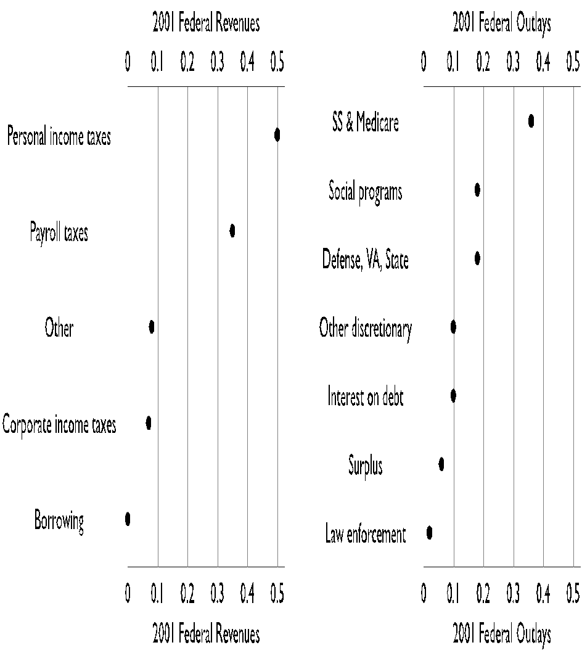
Evaluating pie charts …
A dot plot is at least as good as providing this information.
Unlike the pie chart, 10 categories can be accommodated without any problem.
Note that the plot was diagonalized to facilitate comparisons.

Slide 37
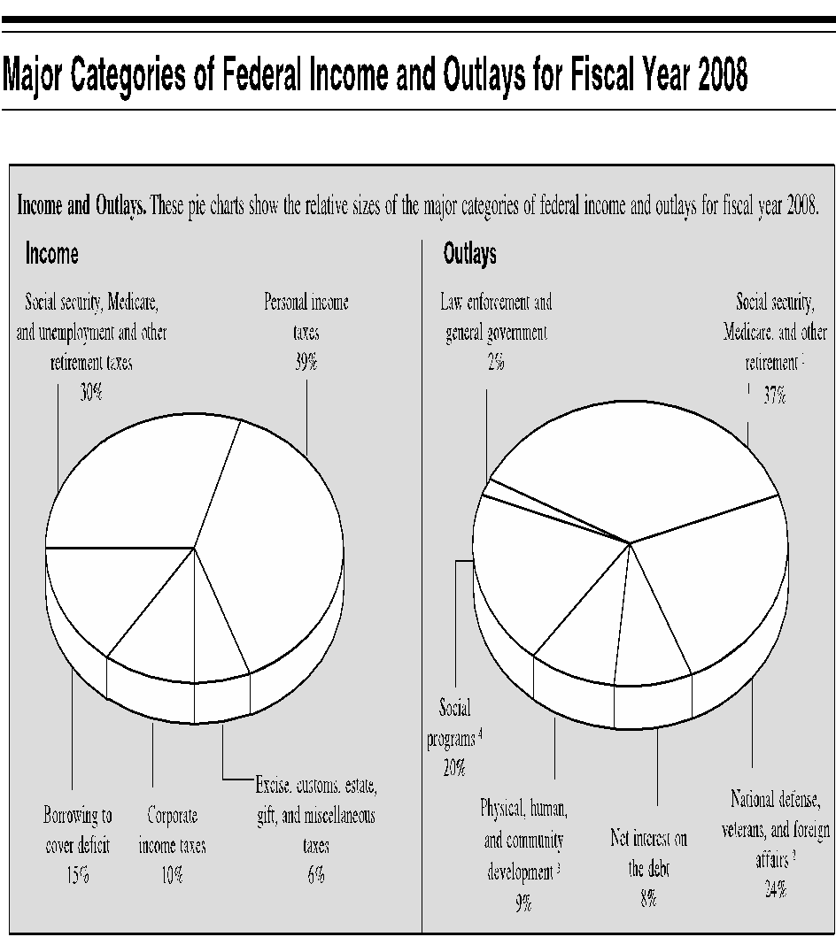
Evaluating pie charts …
Budget information went missing for most of the decade, but made a come back in 2009.
What has changed between 2001 and 2008 (besides the president)?
Looking at the pie charts side by side is difficult to tell.

Slide 38
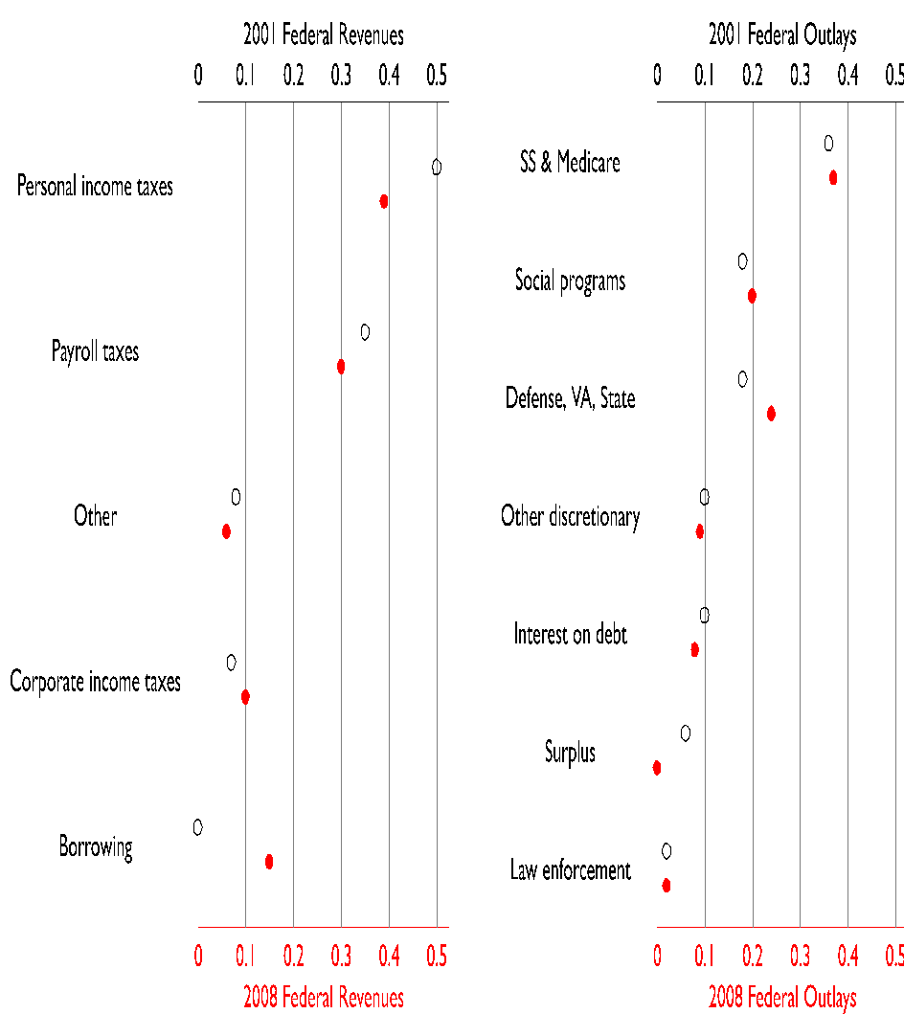
Evaluating pie charts …
Comparisons are simplified because we are using visual cues that are higher in the cognitive scale AND because we share the same scale.
Bar plots could also have been used, do you see any advantage or disadvantage?

Slide 39
Take home message …
Try to avoid bubbles, areas if accurate comparisons are important.
There is almost always a better alternative than pie charts!
However, areas and bubbles can still be a helpful tool if accurate comparisons are not key and if you build in redundancy in your visualization.

Slide 40
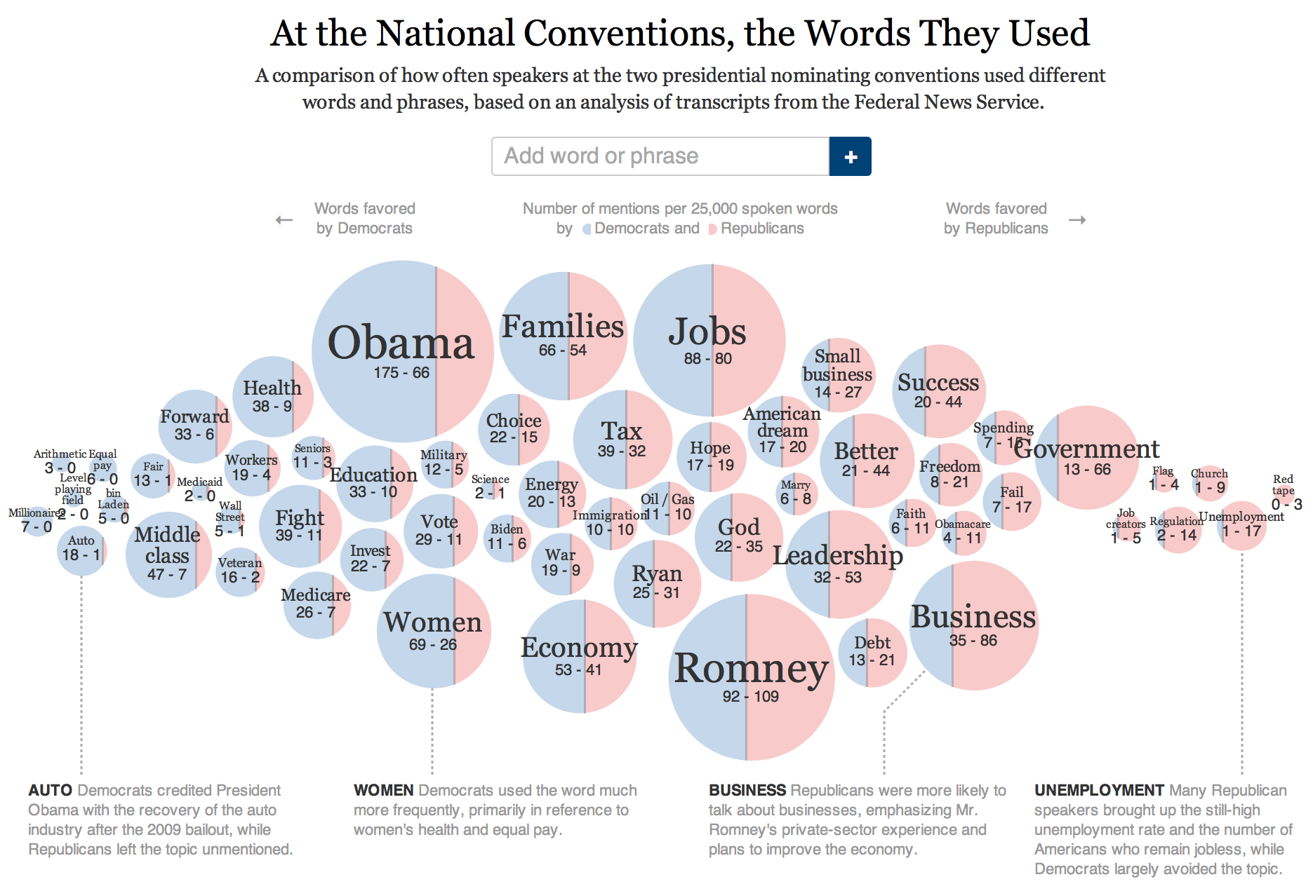
Redundancy in visualization
The relative usage of the word by democrats is encoded by both the blue area in each circle
and by the position of the circle in the x axis.
http://www.nytimes.com/interactive/2012/09/06/us/politics/convention-word-counts.html?_r=0

Slide 41
Using color
When dealing with categorical variables, color can be a very useful visual clue that allows us to quickly differentiate among groups, particularly when their number is moderate.
When used to represent continuous variables, color is at the bottom of the cognitive hierarchy, as it is does not allow for very effective comparisons.

Slide 42
General rules
When representing categorical variables, either use conventions (e.g., Republicans in red and Democrats in blue). If no convention exists use colors that achieve equal pairwise distinction.
When representing continuous quantities, use smooth gradients.
Avoid overlapping colors with similar brightness.
Use pastels for large area colors and saturated colors for small points.
But, what is color?

Slide 43
How the eye perceives color
Human eyes contain two kinds of photo-receptive elements:
Rods: sensitive to brightness. Single photon receptors, little use in sunlight.
Cones: Come in three varieties.
Short wavelength (red); most sensitive.
Medium wavelength (green); moderately sensitive.
Long wavelength (blue); weak.
Humans are best at seeing red, worst at seeing blue!
Mixing the three (human) primary colors yield any color humans can see.

Slide 44
How the eye perceives color
The number of cones determines how many primary colors a species perceives:
Dogs have only two cones and are red-green colorblind.
Chickens have 12 different types of cones!
Color blindness (sometimes called daltonism) is a genetic condition that manifest in inability to perceive certain colors.
Different types, but red-green is by far the most common, and affects between 8% and 10% of males. Very few women suffer from color blindness.

Slide 45
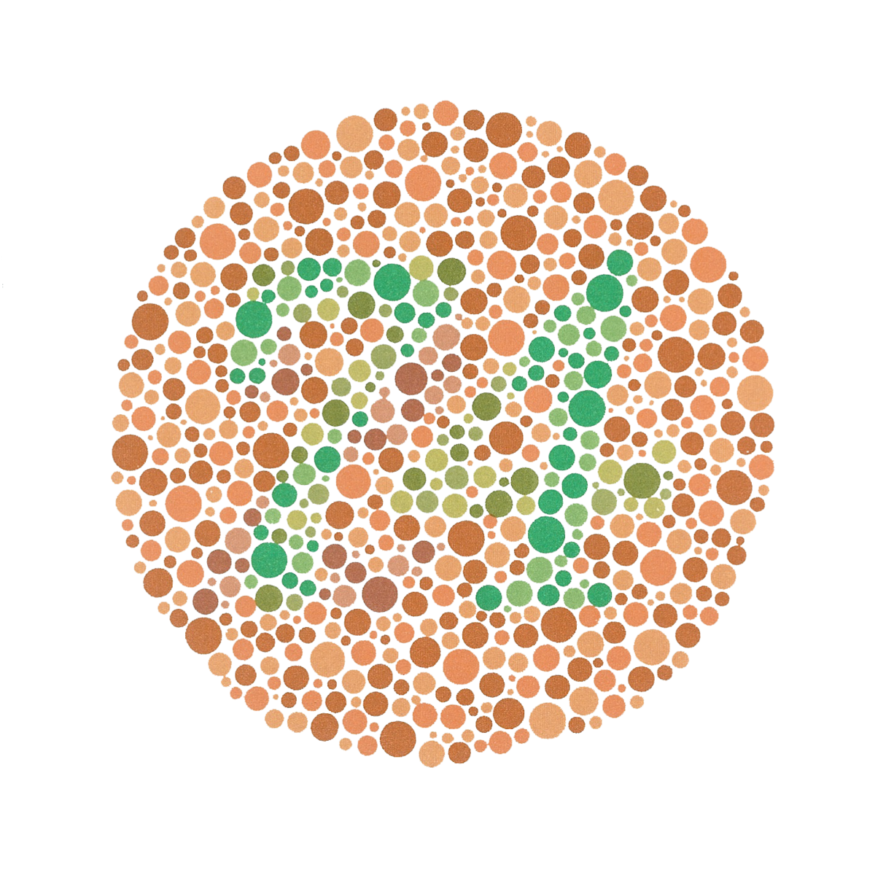
How the eye perceives color
Ishihara color test: can you see the number 74?
Consider color blind individuals when creating your visualization: if you can, avoid using both green and red in your visualization, particularly if they appear adjacent to each other.
Simulator: https://pilestone.com/pages/color-blindness-simulator-1

Slide 46
How the eye perceives color
Opponent color (or antagonistic color) theory states that the human visual system interprets information about color by processing signals from cones and rods in an antagonistic manner.
Redness is contrasted with greenness.
Blueness is contrasted with yellowness.
Darkness is contrasted with brightness.
These pairs are indeed mutually exclusive (no one ever says “the yellowish-blue car”).

Slide 47
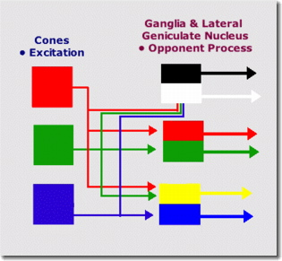
Opponent color theory

Slide 48
Representing colors
Two main types of color scales:
Computer scales: mainly CMYK (for Cyan- Magenta-Yellow-Black) and RGB scale (for Red-Green-Blue).
Perceptual scales: PANTONE® Color System, HSV (for Hue-Lightness-Saturation), CIElab (where l stands for luminance – white vs. black –, a stands for red vs. green, and b stands for blue vs. green) Hue is what we usually call color (blue, green brown, etc), Saturation is the richness of the color (solids vs. pastels) and value is how much black or white is mixed in (stop-sign red vs. red wine).

Slide 49
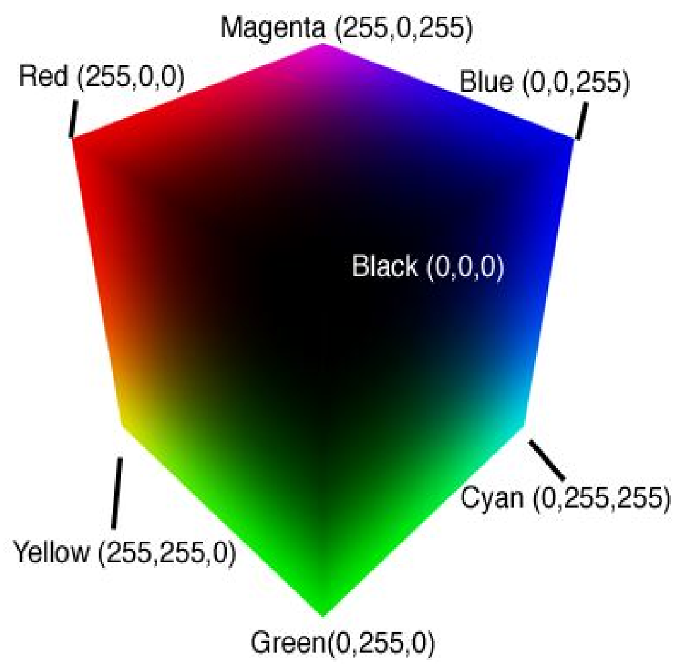
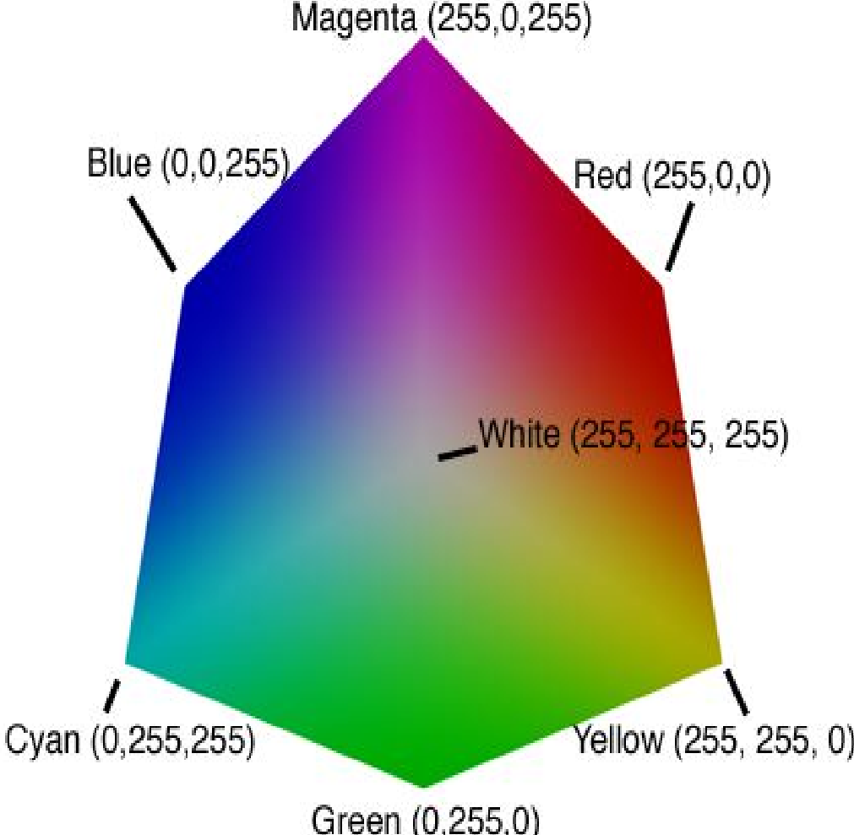
The RGB scale
The black corner of the RGB cube
The white corner of the RGB cube
The RGB scale is mathematically beautiful, but not very intuitive for the regular individual.

Slide 50
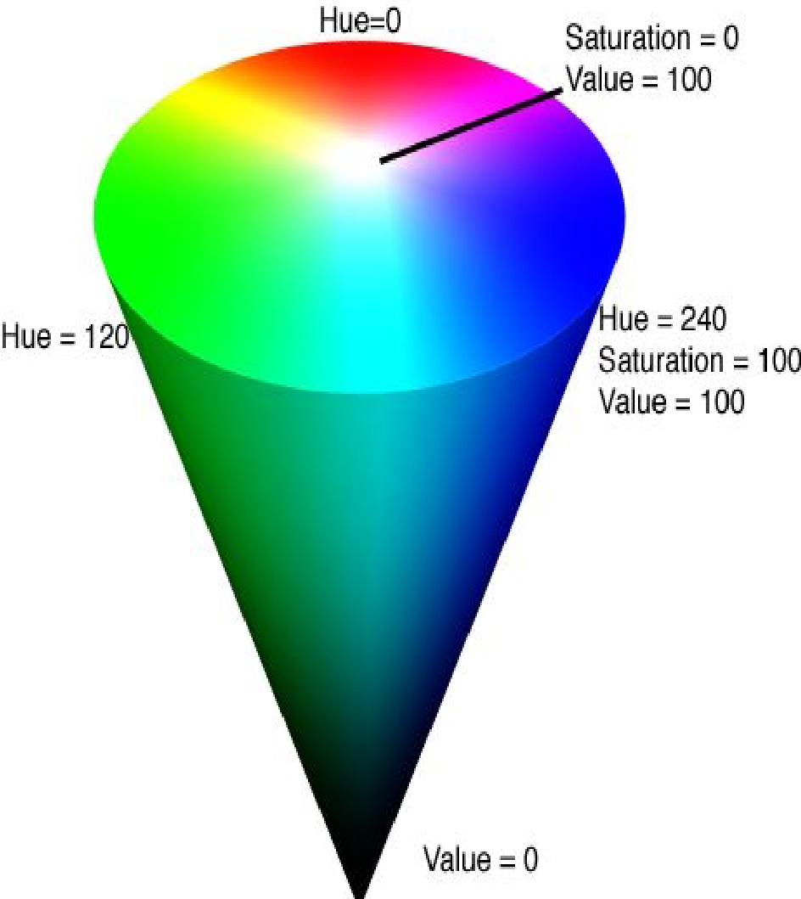
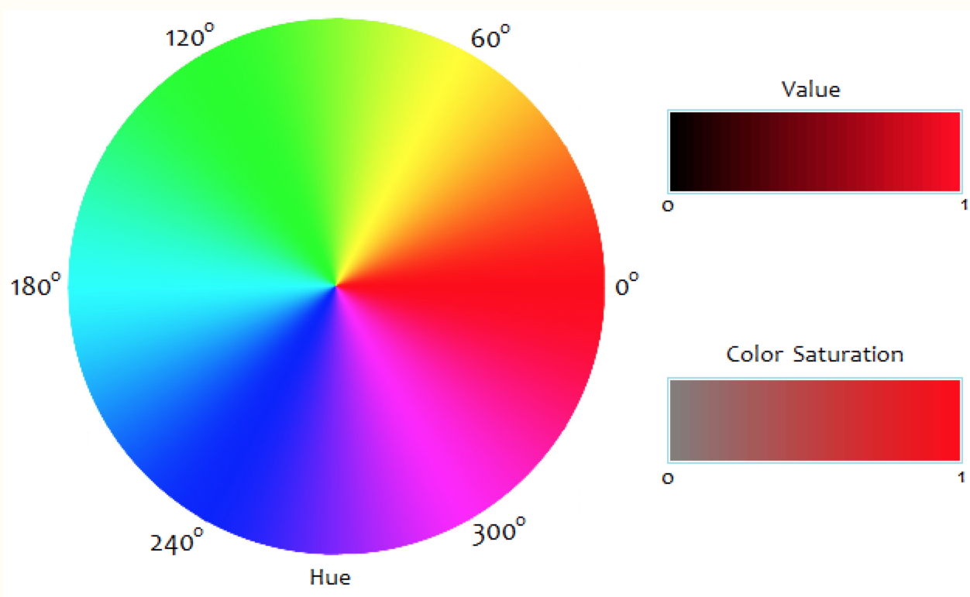
The HSV scale

Slide 51
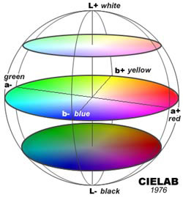
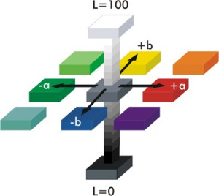
The CIElab scale

Slide 52
What scale is more useful?
The RGB scale is mathematically beautiful and convenient for computers. However, for the average person the RGB is difficult to understand. Furthermore, colors that are “close” in the RGB scale are not necessarily perceived as being “close” by most people.
HSV is easier for humans to interpret (e.g., facilitates color selection and color matching) , but does not necessarily good differentiation.
CIElab scale is the brain’s color scale, and the best for picking colors for scientific visualization:
If you want to convey distinct categories, choose colors that are well separated in CIElab space.
If you want to convey precise numerical steps, choose equal steps through CIElab space.

Slide 53
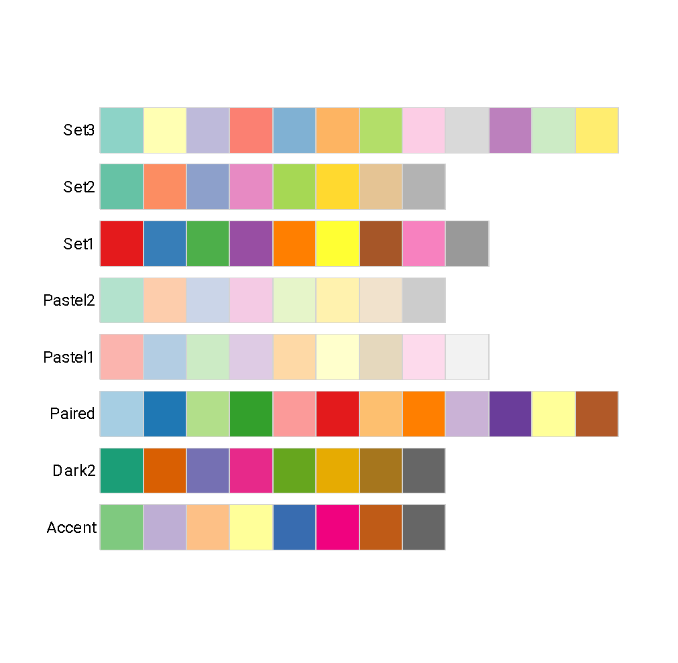
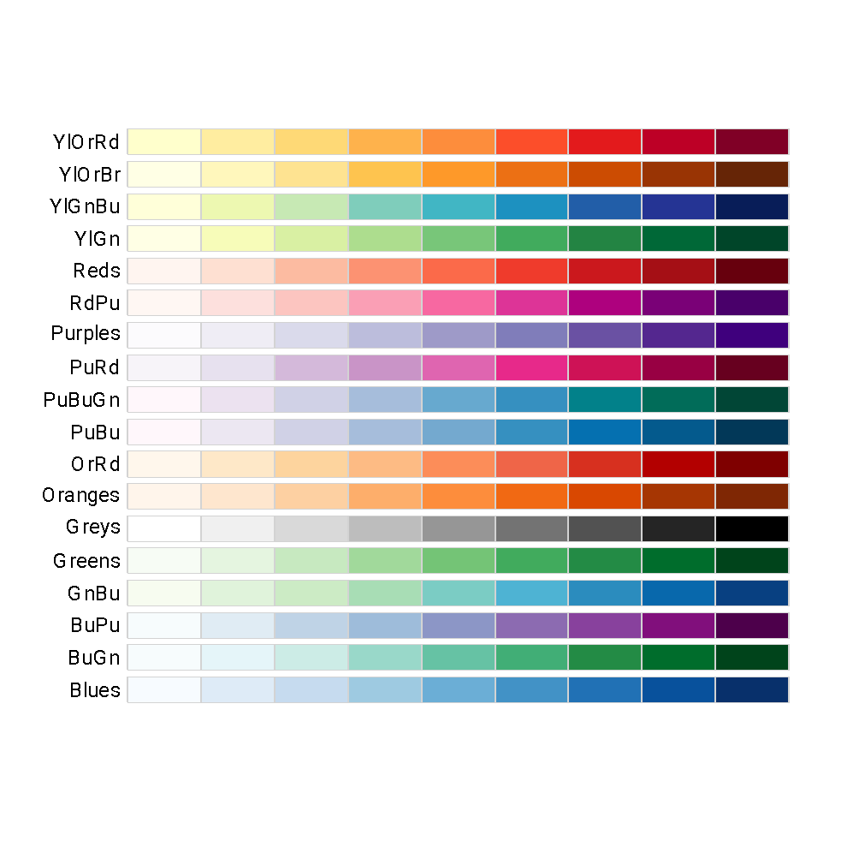
Examples of CIElab palettes
Scales for qualitative variables
Scales for quantitative variables

Slide 54
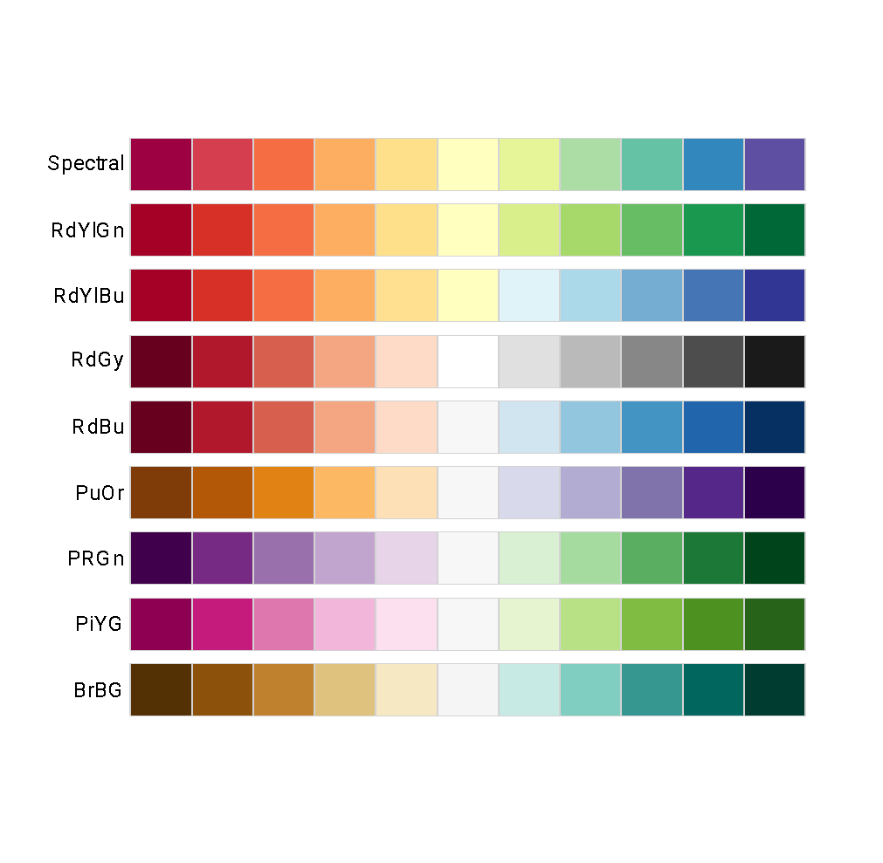
Examples of CIElab palettes
Sequential scale (same as before)
Divergent scale

Slide 55
Examples of CIElab palettes
Sequential scale
RGB codes
Set3 | #8DD3C7 | #FFFFB3 | #BEBADA | #FB8072 | #80B1D3 | #FDB462 | #B3DE69 | #FCCDE5 | #D9D9D9 | #BC80BD | #CCEBC5 | #FFED6F
Set2 | #66C2A5 | #FC8D62 | #8DA0CB | #E78AC3 | #A6D854 | #FFD92F | #E5C494 | #B3B3B3
Set1 | #E41A1C | #377EB8 | #4DAF4A | #984EA3 | #FF7F00 | #FFFF33 | #A65628 | #F781BF | #999999
Pastel2 | #B3E2CD | #FDCDAC | #CBD5E8 | #F4CAE4 | #E6F5C9 | #FFF2AE | #F1E2CC | #CCCCCC
Pastel1 | #FBB4AE | #B3CDE3 | #CCEBC5 | #DECBE4 | #FED9A6 | #FFFFCC | #E5D8BD | #FDDAEC | #F2F2F2
Paired | #A6CEE3 | #1F78B4 | #B2DF8A | #33A02C | #FB9A99 | #E31A1C | #FDBF6F | #FF7F00 | #CAB2D6 | #6A3D9A | #FFFF99 | #B15928
Dark2 | #1B9E77 | #D95F02 | #7570B3 | #E7298A | #66A61E | #E6AB02 | #A6761D | #666666
Accent | #7FC97F | #BEAED4 | #FDC086 | #FFFF99 | #386CB0 | #F0027F | #BF5B17 | #666666

Slide 56
Examples of CIElab palettes
Sequential scale
RGB codes
YlOrRd | #FFFFCC | #FFEDA0 | #FED976 | #FEB24C | #FD8D3C | #FC4E2A | #E31A1C | #BD0026 | #800026
YlOrBr | #FFFFE5 | #FFF7BC | #FEE391 | #FEC44F | #FE9929 | #EC7014 | #CC4C02 | #993404 | #662506
YlGnBu | #FFFFD9 | #EDF8B1 | #C7E9B4 | #7FCDBB | #41B6C4 | #1D91C0 | #225EA8 | #253494 | #081D58
YlGn | #FFFFE5 | #F7FCB9 | #D9F0A3 | #ADDD8E | #78C679 | #41AB5D | #238443 | #006837 | #004529
Reds | #FFF5F0 | #FEE0D2 | #FCBBA1 | #FC9272 | #FB6A4A | #EF3B2C | #CB181D | #A50F15 | #67000D
RdPu | #FFF7F3 | #FDE0DD | #FCC5C0 | #FA9FB5 | #F768A1 | #DD3497 | #AE017E | #7A0177 | #49006A
Purples | #FCFBFD | #EFEDF5 | #DADAEB | #BCBDDC | #9E9AC8 | #807DBA | #6A51A3 | #54278F | #3F007D
PuRd | #F7F4F9 | #E7E1EF | #D4B9DA | #C994C7 | #DF65B0 | #E7298A | #CE1256 | #980043 | #67001F
PuBuGn | #FFF7FB | #ECE2F0 | #D0D1E6 | #A6BDDB | #67A9CF | #3690C0 | #02818A | #016C59 | #014636
PuBu | #FFF7FB | #ECE7F2 | #D0D1E6 | #A6BDDB | #74A9CF | #3690C0 | #0570B0 | #045A8D | #023858
OrRd | #FFF7EC | #FEE8C8 | #FDD49E | #FDBB84 | #FC8D59 | #EF6548 | #D7301F | #B30000 | #7F0000
Oranges | #FFF5EB | #FEE6CE | #FDD0A2 | #FDAE6B | #FD8D3C | #F16913 | #D94801 | #A63603 | #7F2704
Greys | #FFFFFF | #F0F0F0 | #D9D9D9 | #BDBDBD | #969696 | #737373 | #525252 | #252525 | #000000
Greens | #F7FCF5 | #E5F5E0 | #C7E9C0 | #A1D99B | #74C476 | #41AB5D | #238B45 | #006D2C | #00441B
GnBu | #F7FCF0 | #E0F3DB | #CCEBC5 | #A8DDB5 | #7BCCC4 | #4EB3D3 | #2B8CBE | #0868AC | #084081
BuPu | #F7FCFD | #E0ECF4 | #BFD3E6 | #9EBCDA | #8C96C6 | #8C6BB1 | #88419D | #810F7C | #4D004B
BuGn | #F7FCFD | #E5F5F9 | #CCECE6 | #99D8C9 | #66C2A4 | #41AE76 | #238B45 | #006D2C | #00441B
Blues | #F7FBFF | #DEEBF7 | #C6DBEF | #9ECAE1 | #6BAED6 | #4292C6 | #2171B5 | #08519C | #08306B

Slide 57
Examples of CIElab palettes
Divergent scale
RGB codes
Spectral | #9E0142 | #D53E4F | #F46D43 | #FDAE61 | #FEE08B | #FFFFBF | #E6F598 | #ABDDA4 | #66C2A5 | #3288BD | #5E4FA2
RdYlGn | #A50026 | #D73027 | #F46D43 | #FDAE61 | #FEE08B | #FFFFBF | #D9EF8B | #A6D96A | #66BD63 | #1A9850 | #006837
RdYlBu | #A50026 | #D73027 | #F46D43 | #FDAE61 | #FEE090 | #FFFFBF | #E0F3F8 | #ABD9E9 | #74ADD1 | #4575B4 | #313695
RdGy | #67001F | #B2182B | #D6604D | #F4A582 | #FDDBC7 | #FFFFFF | #E0E0E0 | #BABABA | #878787 | #4D4D4D | #1A1A1A
RdBu | #67001F | #B2182B | #D6604D | #F4A582 | #FDDBC7 | #F7F7F7 | #D1E5F0 | #92C5DE | #4393C3 | #2166AC | #053061
PuOr | #7F3B08 | #B35806 | #E08214 | #FDB863 | #FEE0B6 | #F7F7F7 | #D8DAEB | #B2ABD2 | #8073AC | #542788 | #2D004B
PRGn | #40004B | #762A83 | #9970AB | #C2A5CF | #E7D4E8 | #F7F7F7 | #D9F0D3 | #A6DBA0 | #5AAE61 | #1B7837 | #00441B
PiYG | #8E0152 | #C51B7D | #DE77AE | #F1B6DA | #FDE0EF | #F7F7F7 | #E6F5D0 | #B8E186 | #7FBC41 | #4D9221 | #276419
BrBG | #543005 | #8C510A | #BF812D | #DFC27D | #F6E8C3 | #F5F5F5 | #C7EAE5 | #80CDC1 | #35978F | #01665E | #003C30

Slide 58
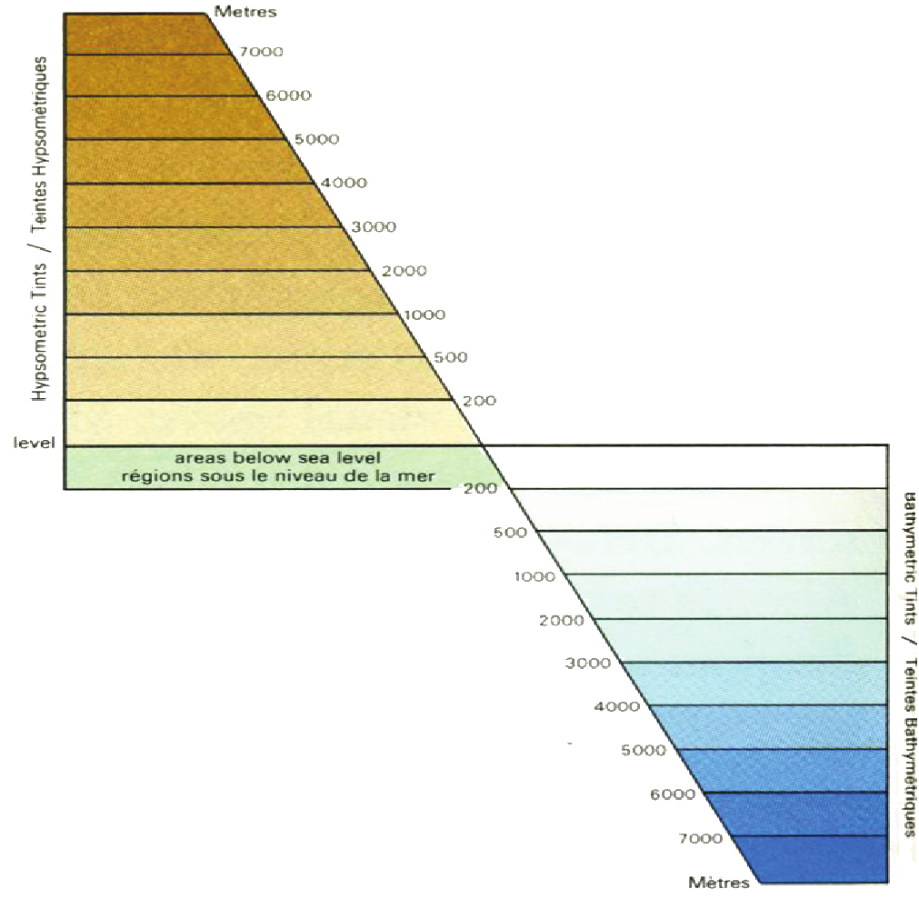
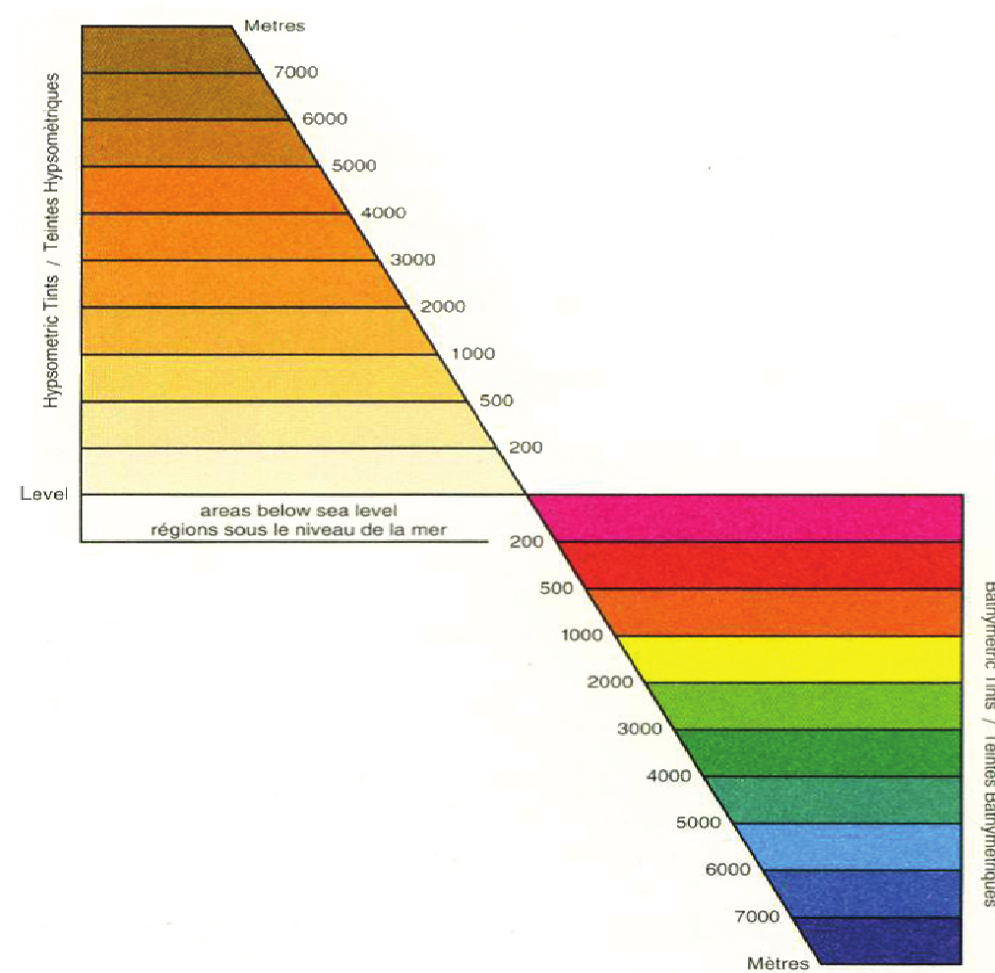
An example …
A good color palette
A terrible color palette

Slide 59
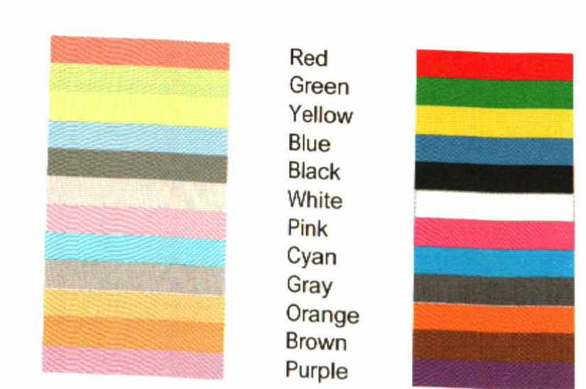
Using color
It might be useful to have two different palettes with the same hues but different saturations:
Use the low saturation (pastel) palette for items that do not need to stand out and high saturation colors to highlight important information.

Slide 60
Additional discussion
In addition to the course textbooks, see
http://www.perceptualedge.com/articles/visual_business_intelligence/rules_for_using_color.pdf
for additional suggestions and examples.

Slide 61
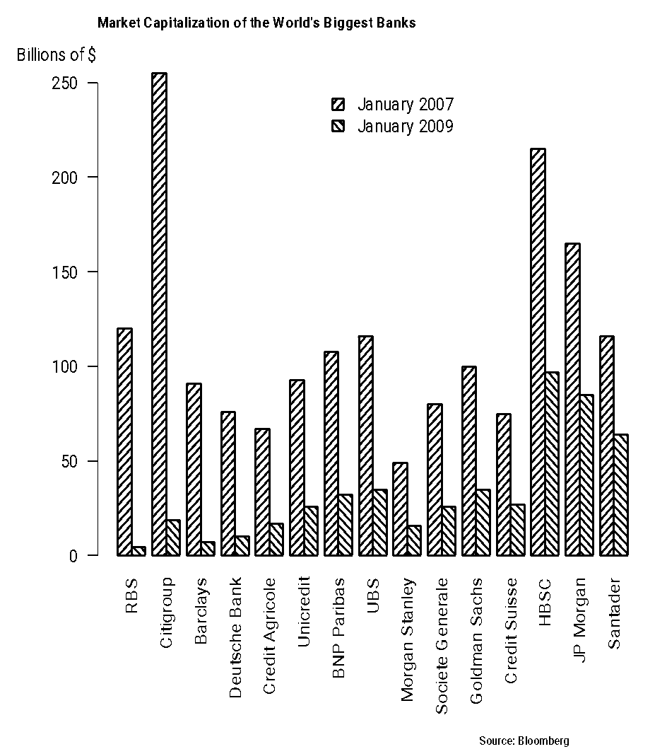
Shading lines as alternatives to color
Shading lines are a common alternative to color:
Avoid shading lines, particularly dissonant combinations! The moiré vibration effect.
If you can’t use color, use shades of grey for a more pleasant look.

